Slide 1
Course : COMP8029 – IT Security and Risk Management
Period : September / February 20XX
Incident Response Preparation, Organisation and Prevention
Session 09
KDS – Name SME

Slide 2
Objectives
Know the process used to organize the incident response process
Understand how policy affects the incident response planning process and how policy can be implemented to support incident response practices
Know the techniques that can be employed when forming a security incident response team (SIRT)
Learn the skills and components required to devise an incident response plan
Know some of the concerns and trade-offs to be managed when assembling the final IR plan
Principles of Incident Response and Disaster Recovery

Slide 3
Introduction
Contingency planning addresses everything done by an organization to prepare for the unexpected
Incident response (IR) process: focuses on detecting or attempting to detect and evaluate the level of severity of unexpected events
IR process should contain or resolve incidents
If not possible to contain or resolve, other elements of contingency planning process are activated
Principles of Incident Response and Disaster Recovery

Slide 4
Introduction (continued)
Incident response process consists of:
  Preparation
  Detection and analysis
  Containment
  Eradication and recovery
  Post-incident activity
This chapter focuses on preparation
Principles of Incident Response and Disaster Recovery

Slide 5
Preparing for Incident Response
When CPMT completes each component of the BIA, it transfers that information to the subordinate committees
Subordinate committees follow these stages:
  Form the IR planning committee
  Develop the IR policy
  Organize the SIRT
  Develop the IR plan
  Develop IR procedures
Two approaches:
  NIST (National Institute of Standards & Technology)
  CERT (Computer Emergency Response Team)
Principles of Incident Response and Disaster Recovery

Slide 6
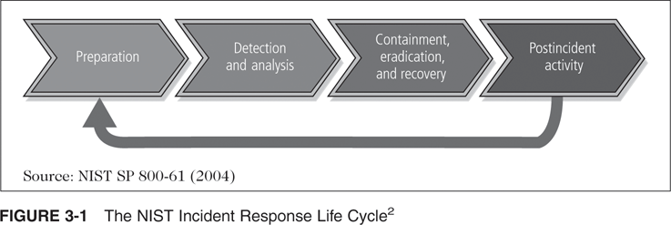
Preparing for Incident Response (continued)
Principles of Incident Response and Disaster Recovery

Slide 7
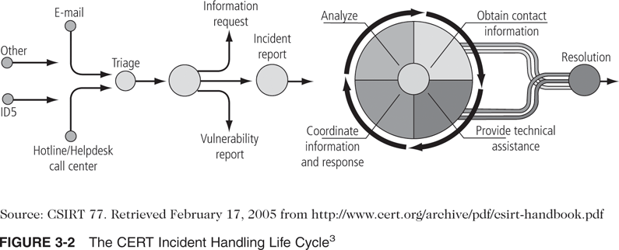
Preparing for Incident Response (continued)
Principles of Incident Response and Disaster Recovery

Slide 8
Preparing for Incident Response (continued)
IR team must identify and engage stakeholders:
  Communities of interest such as general management, IT management, and InfoSec management
  Organizational departments such as Legal and HR
  Public Relations department
  General end users
  Other groups such as physical security, auditing and risk management, insurance, key business partners, contractors, temporary employee agencies, and consultants
Principles of Incident Response and Disaster Recovery

Slide 9
Incident Response Policy
IR Policy should be the first deliverable
Security Incident Response Team (SIRT) should join the IR planning committee to develop policy
IR policy:
  Defines the roles and responsibilities for incident response for the SIRT and others who will be mobilized
Principles of Incident Response and Disaster Recovery

Slide 10
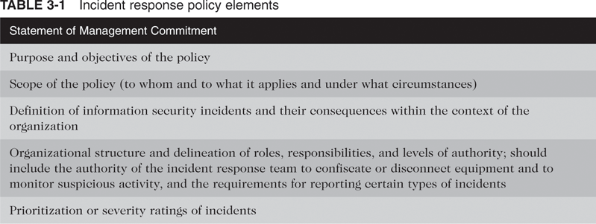
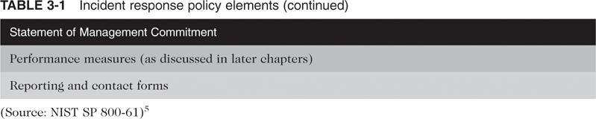
Incident Response Policy (continued)
Principles of Incident Response and Disaster Recovery

Slide 11
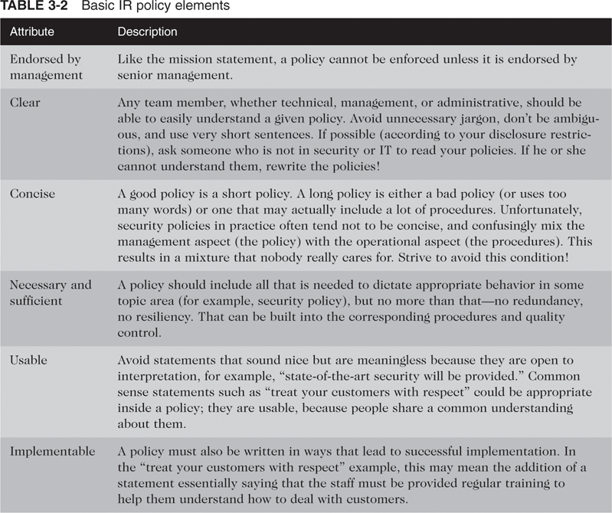
Incident Response Policy (continued)
Principles of Incident Response and Disaster Recovery

Slide 12
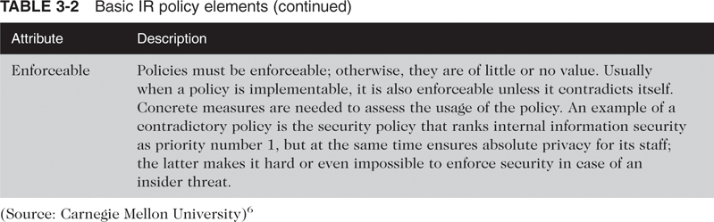
Incident Response Policy (continued)
Principles of Incident Response and Disaster Recovery

Slide 13
Incident Response Policy (continued)
Other teams should provide input:
  Disaster recovery
  Business continuity
Other sources may include:
  Organization charts
  Topologies for systems and networks
  Critical system and asset inventories
  Existing disaster recovery, business continuity plans, incident response plans
  Parental or institutional regulations
  Existing security policies and procedures
Principles of Incident Response and Disaster Recovery

Slide 14
Building the Security Incident Response Team
SIRT may be a formal or informal team
If formal, SIRT is a set of policies, procedures, technologies, people, and data necessary to prevent, detect, react, and recover from an incident
Development of SIRT involves these stages:
  Collecting information from stakeholders
  Defining the IR team structure
  Determining the IR team services
Principles of Incident Response and Disaster Recovery

Slide 15
Information Collection from Stakeholders
IR planning committee must establish the scope and responsibilities of the SIRT
Typical skills required of a SIRT team include:
  Virus scanning, elimination, and recovery
  System administration
  Network administration (switches, routers, gateways)
  Firewall administration
  Intrusion detection systems
  Cryptography
  Data storage and recovery (RAID, SAN)
  Documentation creation and maintenance
Principles of Incident Response and Disaster Recovery

Slide 16
Information Collection from Stakeholders (continued)
Incident Response team analyzes incident data, determines impact, and acts to limit damage and restore normal services
Possible team models:
  Central IR team
  Distributed IR teams
  Coordinating team
Central IR team:
  One team handles incidents throughout the organization
  Effective for small organizations with minimal geographical diversity
Principles of Incident Response and Disaster Recovery

Slide 17
Information Collection from Stakeholders (continued)
Distributed IR teams:
  Each team is responsible for a physical segment of the organization
  Effective for large organizations with major computing resources at remote locations
Coordinating team:
  IR team provides guidance and advice to other teams but does not have authority over them
  Can be thought of as “a SIRT for a SIRT”
Principles of Incident Response and Disaster Recovery

Slide 18
Information Collection from Stakeholders (continued)
IR team possible staffing models:
  Employees: all IR work is performed by the organization
  Partially outsourced: e.g., offsite managed security services provider (MSSP) for 24/7 monitoring of intrusion detection sensors, firewalls, etc.
  Fully outsourced: all incident response work is outsourced
Principles of Incident Response and Disaster Recovery

Slide 19
Information Collection from Stakeholders (continued)
Factors influencing selection of structure and staffing models:
  Need for 24/7 availability: available to respond, or be onsite 24/7
  Full-time vs. part-time team members: dedicated to IR, or potentially available when needed
  Employee morale: IR work requires odd hours, on-call, stressful work
  Cost
  Staff expertise
  Organizational structure
  Outsourcing incident response
Principles of Incident Response and Disaster Recovery

Slide 20
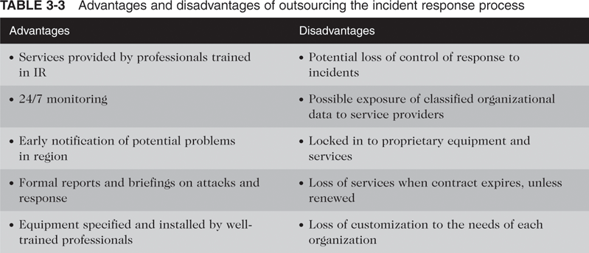
Information Collection from Stakeholders (continued)
Principles of Incident Response and Disaster Recovery

Slide 21
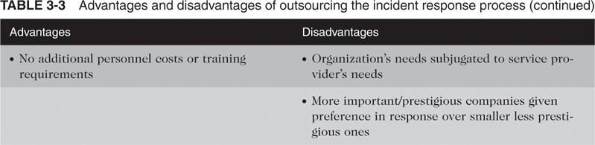
Information Collection from Stakeholders (continued)
Principles of Incident Response and Disaster Recovery

Slide 22
Information Collection from Stakeholders (continued)
When considering outsourcing, consider these factors:
  Current and future quality of work
  Division of responsibilities
  Sensitive information revealed to the contractor
  Lack of organization-specific knowledge
  Lack of correlation among multiple data sources
  Handling incidents at multiple locations
  Maintaining incident response skills in-house
Principles of Incident Response and Disaster Recovery

Slide 23
Information Collection from Stakeholders (continued)
With any model, a single employee should be in charge of incident response
  If outsourced, this person oversees the service provider
  If in-house, this person is the team manager
Team manager’s tasks include:
  Liaison with upper management and other teams
  Defusing crisis situations
  Ensuring the team has necessary personnel, resources, and skills
Principles of Incident Response and Disaster Recovery

Slide 24
Information Collection from Stakeholders (continued)
May also want to have a team technical lead:
  Has oversight of and final responsibility for quality of technical work performed by the IR team
  Do not confuse this with the incident lead person (primary point of contact for handling an incident)
IR team members should have excellent technical skills and good problem-solving and troubleshooting skills
IR team members should also have good communication, writing, and speaking skills
Principles of Incident Response and Disaster Recovery

Slide 25
Information Collection from Stakeholders (continued)
Consider dependencies within organizations: what other groups need to participate in incident handling?
IR team services can be grouped into 3 categories:
  Reactive services: triggered by an event or request
  Proactive services: provide assistance and information to prepare, protect, and secure systems
  Security quality management services: augment existing services related to security, such as auditing and training
Principles of Incident Response and Disaster Recovery

Slide 26
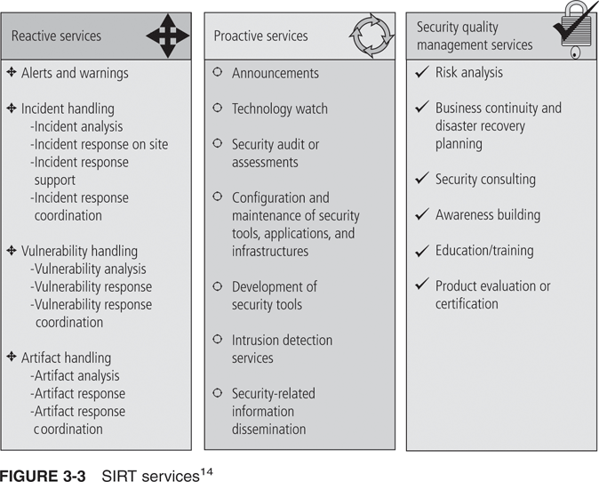
Information Collection from Stakeholders (continued)
Principles of Incident Response and Disaster Recovery

Slide 27
Information Collection from Stakeholders (continued)
Typical IR team services:
  Advisory distribution
  Vulnerability assessment
  Intrusion detection
  Education and awareness
  Technology watch and recommendations
  Patch management
Principles of Incident Response and Disaster Recovery

Slide 28
Information Collection from Stakeholders (continued)
NIST recommends that federal agencies:
  Establish IR capabilities
  Create IR policy
  Establish policies and procedures for information sharing
  Provide incident information to other organizations
  Select an IR team model
  Select the IR team members
  Determine which services the team should offer
Principles of Incident Response and Disaster Recovery

Slide 29
Incident Response Planning
Incident response plan: detailed set of processes and procedures that anticipate, detect, and mitigate the effects of an unexpected event
Incident: an event that threatens the security of the organization’s information resources and/or assets, causing actual damage or other disruptions
A threat turns into a valid attack if it has all of these characteristics:
  Directed against the organization’s information assets
  Has a realistic chance of success
  Threatens the confidentiality, integrity, or availability of information resources and assets
Principles of Incident Response and Disaster Recovery

Slide 30
Incident Response Planning (continued)
IR procedures are reactive measures, not preventive controls
Chief Information Security Officer (CISO): has responsibility for creating an organization’s IR plan
For every attack scenario and end case, IR team creates three sets of incident-handling procedures:
  During the incident
  After the incident
  Before the incident
Principles of Incident Response and Disaster Recovery

Slide 31
Incident Response Planning (continued)
IR planning team also adds other information:
  Trigger: circumstances that cause the IR plan to be initiated
  Notification method: manner in which the team receives notification of an incident
  Response time: time limit within which the team should respond
Principles of Incident Response and Disaster Recovery

Slide 32
Planning for the Response
During the Incident
The reaction to the incident is the most important phase of the IR plan
Trigger: the circumstances that cause the IR team to be activated and the IR plan to be initiated
IR duty officer: a SIRT team member who is monitoring for signals of incidents
Reaction Force: the individuals with the unique combination of skills needed to respond to the incident
Principles of Incident Response and Disaster Recovery

Slide 33
Planning for the Response
During the Incident (continued)
Reaction Force
  Should be specified in the attack scenario end case
  Should include the scribe, archivist, or historian who develops and maintains a log of events for later review
Actions taken during the incident:
  Verify an actual incident is occurring
  Determine the extent of exposure
  Attempt to contain or quarantine the damage
  Continue to look for small “flare-ups”
Principles of Incident Response and Disaster Recovery

Slide 34
Planning for After the Incident
Planning after the incident should describe:
  Stages necessary to recover from the most likely events of the incident
  Protection from follow-on incidents
  Forensics analysis
  Action-after review
Forensics analysis
  Process of systematically examining information assets for evidentiary material
  Requires proper training to ensure that evidence is not compromised
Principles of Incident Response and Disaster Recovery

Slide 35
Planning for After the Incident (continued)
After-action review (AAR):
  Detailed examination of all events from detection to recovery
  Includes where the IR plan worked and didn’t work
  Can serve as a training case for future staff
  Is the final action of the IR team for the incident
Principles of Incident Response and Disaster Recovery

Slide 36
Planning for Before the Incident
Before actions:
  Implement good information technology and information security practices
  Implement preventative measures to manage risks
  Ensure preparedness of the IR team
Training the SIRT:
  Can use national training programs such as SANNS, Dept. of Homeland Security, US CERT
  Major hardware/software vendors also provide IR training
  Use online resources
Principles of Incident Response and Disaster Recovery

Slide 37
Planning for Before the Incident (continued)
IR Plan must be tested to identify vulnerabilities, faults, and inefficient processes
Testing strategies:
  Desk check
  Structured walk-through
  Simulation
  Parallel testing
  Full interruption
  War gaming
Principles of Incident Response and Disaster Recovery

Slide 38
Planning for Before the Incident (continued)
Desk check: review the plan and create a list of correct and incorrect components
Structured walk-through:
  Walk through the actual steps and discuss actions
  Can be on-site, or a “chalk-talk”
  Entire team works together
Simulation:
  Simulate the performance of each task
  Individuals work on their own
Principles of Incident Response and Disaster Recovery

Slide 39
Planning for Before the Incident (continued)
Parallel Testing:
  Individuals act as if an incident had occurred, but without interfering with normal operations
Full Interruption:
  Individuals follow each and every procedure, including interruption of service, restoration of data from backups, and notification of appropriate individuals
  Most rigorous, but also very risky
War Gaming:
  Realistic, head-to-head attack and defend information
  National competition: Black Hat, DEFCON
Principles of Incident Response and Disaster Recovery

Slide 40
Planning for Before the Incident (continued)
Common war-gaming strategies:
  Capture the flag
  King of the hill
  Computer simulations
  Defend the flag
  Online programming-level war games
Provide tools and resources for the SIRT
Principles of Incident Response and Disaster Recovery

Slide 41
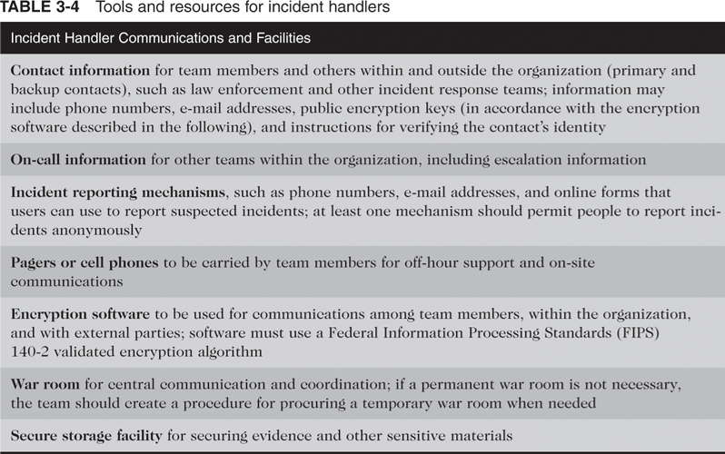
Planning for Before the Incident (continued)
Principles of Incident Response and Disaster Recovery

Slide 42
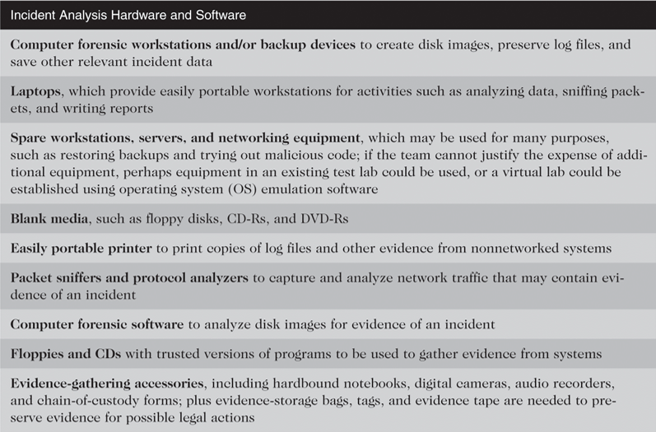
Planning for Before the Incident (continued)
Principles of Incident Response and Disaster Recovery

Slide 43
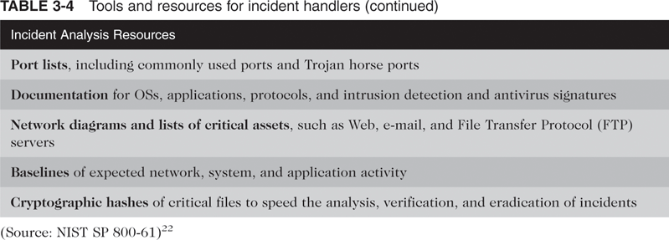
Planning for Before the Incident (continued)
Principles of Incident Response and Disaster Recovery

Slide 44
Planning for Before the Incident (continued)
Training the Users
  Responsibility of the organization’s Security Education Training and Awareness group (SETA)
  Should include:
    Recognizing and reporting an attack
    Mitigating damage
    Good information security practices
  Must train general users, managerial users, and technical users
Training for General Users
  Should be made aware of the plan
Principles of Incident Response and Disaster Recovery

Slide 45
Planning for Before the Incident (continued)
Training for Managerial Users:
  Same as general users, but more personalized
  May require pressure from champion or support at executive level
Training for Technical Users:
  More detailed, and may require use of outside training organizations
Training techniques and delivery methods
  Many possibilities
Principles of Incident Response and Disaster Recovery

Slide 46
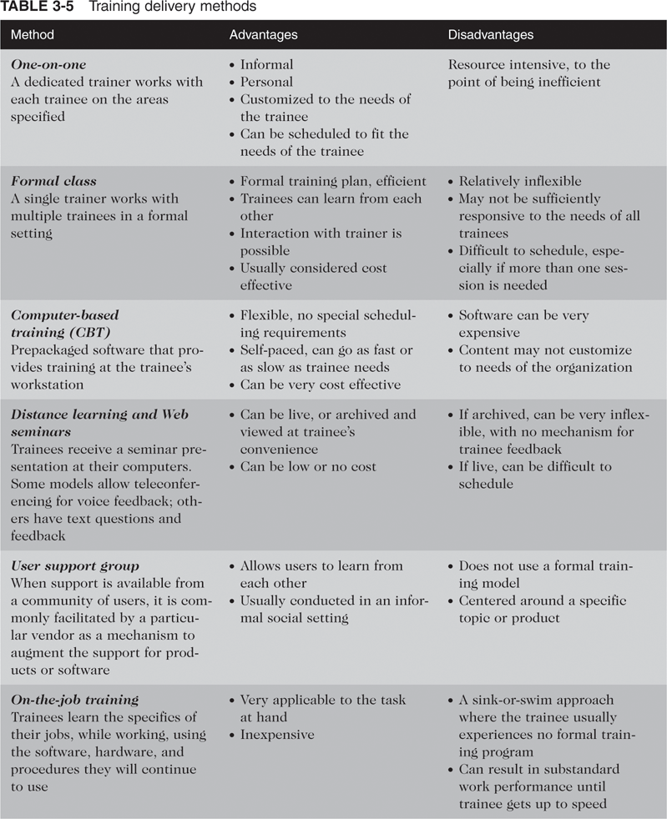
Planning for Before the Incident (continued)
Principles of Incident Response and Disaster Recovery

Slide 47
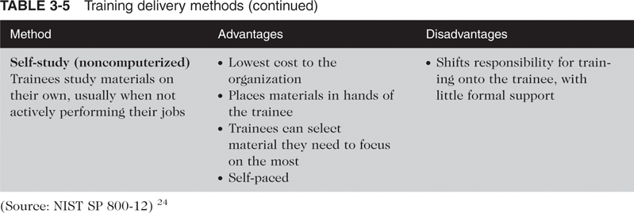
Planning for Before the Incident (continued)
Principles of Incident Response and Disaster Recovery

Slide 48
Assembling and Maintaining the Final Incident Response Plan
Draft plans can be used for training staff and testing steps to validate the effectiveness
Testing does not stop once the final plan is created
Each scenario should be tested at least semiannually
Final plan should be considered classified information, but should be placed in an easy to access location
Principles of Incident Response and Disaster Recovery

Slide 49
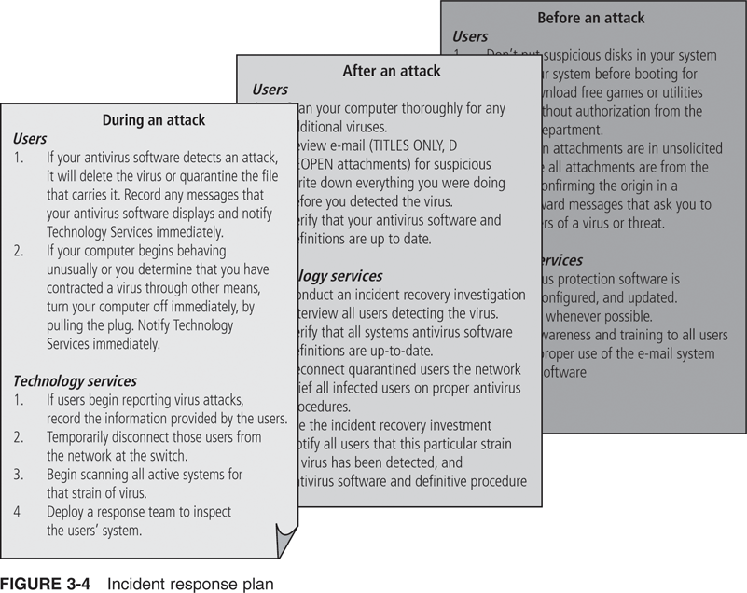
Assembling and Maintaining the Final Incident Response Plan (continued)
Principles of Incident Response and Disaster Recovery

Slide 50
Summary
Incident response process includes preparation, detection, mitigation, and post-incident analysis
IR committee follows these stages:
  Form the IR planning committee
  Develop the IR policy
  Organize the SIRT
  Develop the IR plan
  Develop IR procedures
Staff the IR team with stakeholders from various parts of the organization
Principles of Incident Response and Disaster Recovery

Slide 51
Summary (continued)
Create the IR policy
SIRT is a set of policies, technologies, people, and data necessary to protect, detect, react, and recover from anything that may damage the organization’s information
3 stages to develop the SIRT:
  Collect information from stakeholders
  Define the IR team structure
  Determine the IR team services
Principles of Incident Response and Disaster Recovery

